Slide 1
Montana Clean Indoor Air Act Update
Cherie Murbach, PT, DPT, MPH
Tobacco Education Specialist
Gallatin City-County Health Department
September 2025

Slide 2
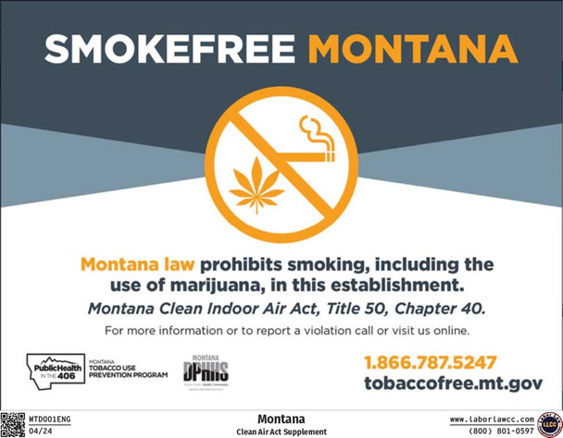
Montana Clean Indoor Air Act (CIAA)
Passed in 2005, requires all:
Enclosed public places and workplaces (including vehicles) be smokefree
  Smoking: the lighting, smoking, or carrying of a lighted cigar, cigarettes, pipe, or any smokable produce and includes the use of marijuana
Businesses to prominently place smokefree signs on all public entrances
Notes:
Enclosed public place means an indoor area, room, or vehicle that the general public is allowed to enter or that serves as a place of work, and includes (but is not limited to) restaurants, stores, public and private office buildings, public transportation, health care facilities, auditoriums, arenas, assembly facilities, bars, meeting rooms open to the public, community college facilities, facilities of the Montana university system and public schools
Does not impact:
Private residences (unless it is used for a family or group day-care home, an adult foster care home or a health care facility )
Private motor vehicles
Hotel or motel rooms designated as smoking rooms
Sites used in connection with the practice of cultural activities by American Indians

Slide 3
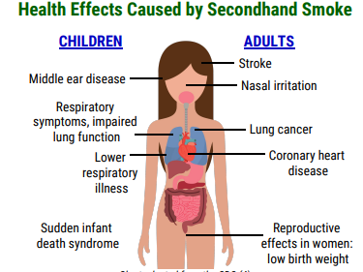
Benefits of the CIAA
Reduce exposure to harmful secondhand smoke exposure
Change community norms related to smoking
  Cigarette smoking among Montana youth has decreased by 75% ¹
Source: Montana Department of Public Health and Human Services. (n.d.)
Notes:
More people will quit, Fewer youth will begin
Current cigarette smoking among youth has decreased from 29% in 2001 to 7% in 2023 – a 75%reduction.

Slide 4
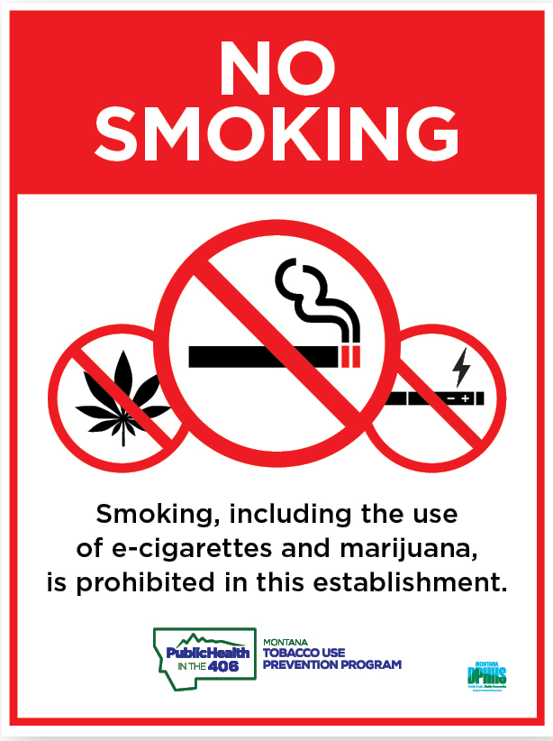
Montana CIAA (2025)
Updated to include the prohibition of electronic smoking devices in public places and workplaces
  Electronic smoking device: an e-cigarette, dab rig, or vape pen containing or delivering nicotine or another substance intended for human consumption that can be used by a person in any manner for the purpose of inhaling vapor or aerosol from the product
Requires updated signage to be displayed on public entrances
Notes:
Enacted May 8, 2025

Slide 5
Benefits of the Expansion
Protect the public from exposure to e-cigarette aerosol
Protect youth from exposure to e-cigarette use
Reduce youth initiation and use

Slide 6
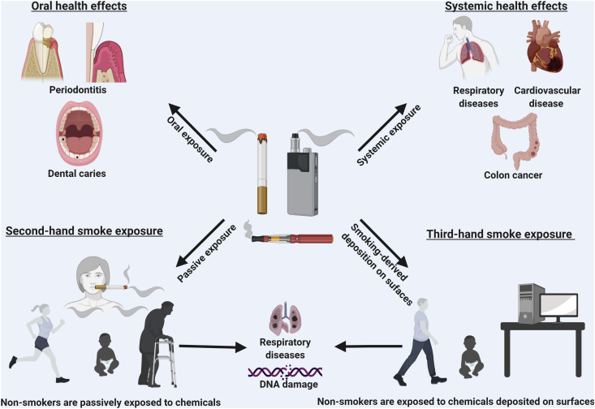
Reduce Exposure to E-Cigarette Aerosol ³
Not a “harmless water vapor”
E-cigarette aerosol contains harmful substances including:
  Nicotine
  Ultrafine particles
  Toxic flavoring
  Volatile organic compounds
  Cancer-causing chemicals
  Heavy metals
Source: Almeida-da-Silva CL, et. al (2021)
Notes:
3:

Slide 7
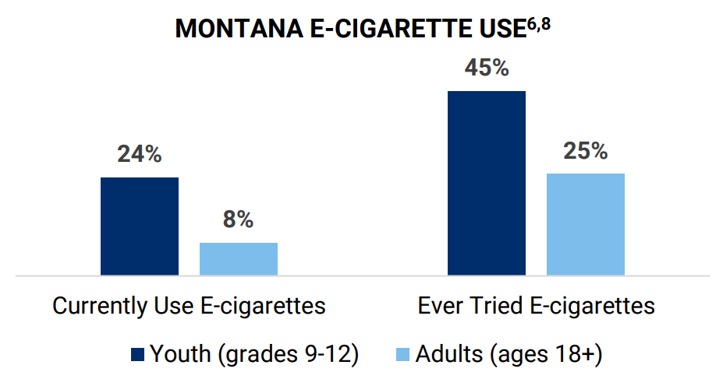
Reduce Youth Initiation and Use
In Gallatin County, 20% of high school students reported e-cigarette use ⁵
Youth nicotine use especially concerning due to the addictive nature of nicotine ⁶
Impact on brain development
Source: Montana Department of Public Health and Human Services, 2024

Slide 8
Reduce Youth Initiation and Use
Use of e-cigarettes normalizes tobacco use ⁷
Youth who use e-cigarettes are four times more likely to smoke in the future than those who do not
Youth who are exposed to pro-vaping community norms are significantly more likely to initiate e-cigarette use ⁸
Altering youth exposure to e-cigarette use can reduce the likelihood that youth will use e-cigarettes in the future

Slide 9
Gallatin County Response
Updated the Gallatin County CIAA Enforcement Procedure
Educating business owners and licensed operators
Disseminating information to the community
Continue to respond to CIAA complaints and violations

Slide 10
Thank You
cherie.murbach@gallatin.mt.gov

Slide 11
References
Montana Department of Public Health and Human Services. (2024). Impact Summary: Montana Tobacco Use Prevention Program (FY 25). Helena, MT: Montana Department of Public Health and Human Services. Retrieved from https://dphhs.mt.gov/assets/publichealth/Tobacco/FactSheet/MTUPPImpactSummaryFY25.pdf dphhs.mt.gov+8dphhs.mt.gov+8dphhs.mt.gov+8
Montana Department of Public Health and Human Services. (n.d.). Montanans have the right to breathe clean air [Infographic]. https://dphhs.mt.gov/assets/publichealth/Tobacco/Publications/MontanansHaveRighttoCleanAirInfographic.pdf
Centers for Disease Control and Prevention. (2023, August 10). Quick facts on the risks of e-cigarettes for kids, teens, and young adults. https://www.cdc.gov/tobacco/e-cigarettes/health-effects.html
Almeida-da-Silva CLC, Matshik Dakafay H, O'Brien K, et al. Effects of electronic cigarette aerosol exposure on oral and systemic health. Biomedical Journal. 2021 Jun;44(3):252-259. DOI: 10.1016/j.bj.2020.07.003. PMID: 33039378; PMCID: PMC8358192.
Montana Office of Public Instruction. (2024, March). 2023 Youth Risk Behavior Survey: County-level results – Gallatin County (County‐level results). Helena, MT: Montana Office of Public Instruction. Retrieved from https://opi.mt.gov/Portals/182/Page%20Files/YRBS/2023YRBS/YRBS%20County%20Level%202023.pdf?ver=2024-03-26-102959-220 news.mt.gov+7opi.mt.gov+7opi.mt.gov+7
Montana Department of Public Health and Human Services. (2024, updated December 6). E‑cigarettes, youth, and nicotine (Fact Sheet). Helena, MT: Montana Department of Public Health and Human Services. Retrieved from https://dphhs.mt.gov/assets/publichealth/Tobacco/FactSheet/EcigsYouthNicotineFY25.pdf
Montana Department of Public Health and Human Services. (2024). Including e‑cigarettes in smokefree laws (EcigarettesSmokefreeLaws_FY25_Accessible_Leg). Helena, MT: Montana Department of Public Health and Human Services. Retrieved from https://dphhs.mt.gov/assets/publichealth/Tobacco/EcigarettesSmokefreeLaws_FY25_Accessible_Leg.pdf dphhs.mt.gov
Piombo, S. E., Barrington-Trimis, J., & Valente, T. W. (2023). Impact of social networks and norms on e-cigarette use among adolescents in Southern California: a prospective cohort study. BMJ public health, 1(1), e000163. https://doi.org/10.1136/bmjph-2023-000163

